Slide 1

Beyond the Hype: Exploring the use of Large Language Models (LLMs) for Researchers
www.linkedin.com/in/filotas-theodosiou
www.linkedin.com/in/filotas-theodosiou
Early Career Forecasters (ECF) Webinar
Filotas Theodosiou
Contact Details:
- filotas.theodosiou@vives.be
- www.linkedin.com/in/filotas-theodosiou
Notes:
Hello people. Thank you for the introduction Anna.
I am Filotas Theodosiou.
Research Associate Vives University in Belgium
- We work with retail partners to improve their forecasting process
We work with education researchers to apply AI in improving teacher-student interactions
We recently started a new project with food-retailers to tackle the issue of food-waste through improved & specialized forecasting processes
In my free time I like studying abou AI and LLMs so I ll try to present as much of this knowledge I have cummulated!!

Slide 2
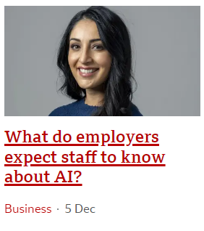
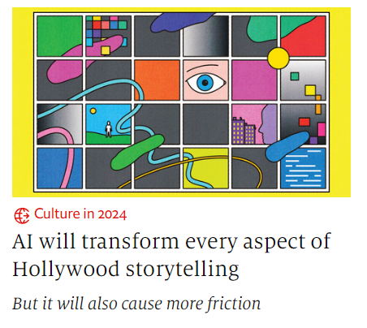
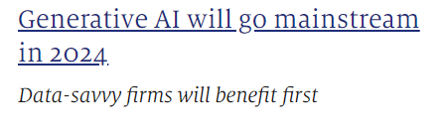
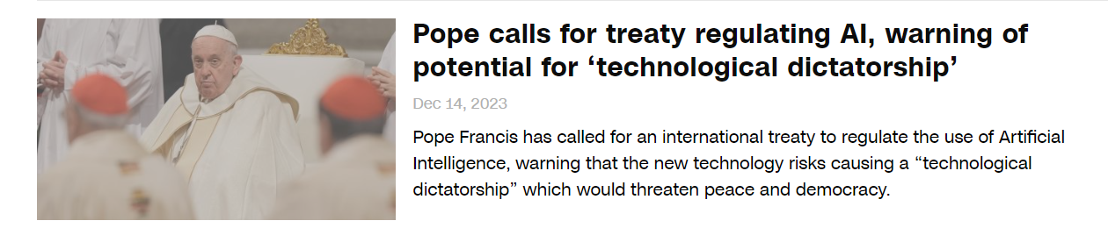
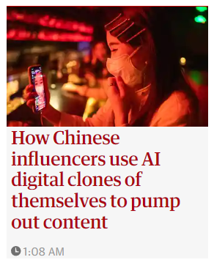

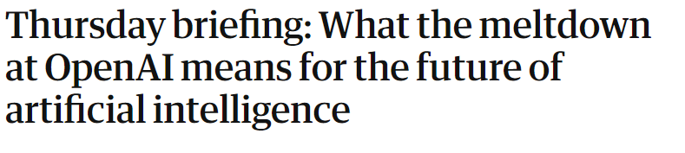
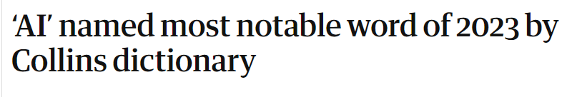

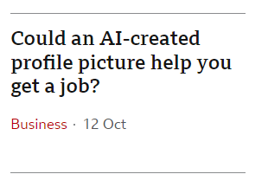
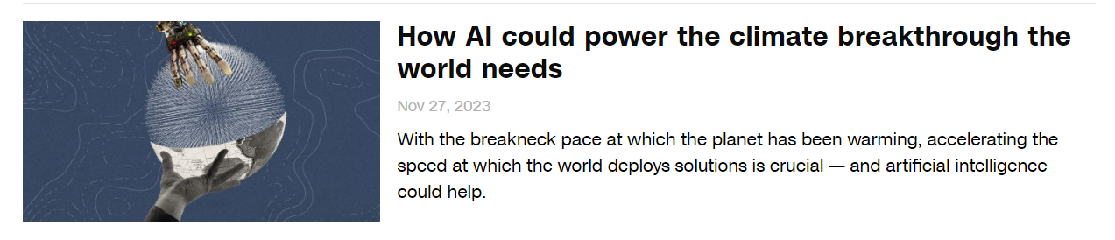
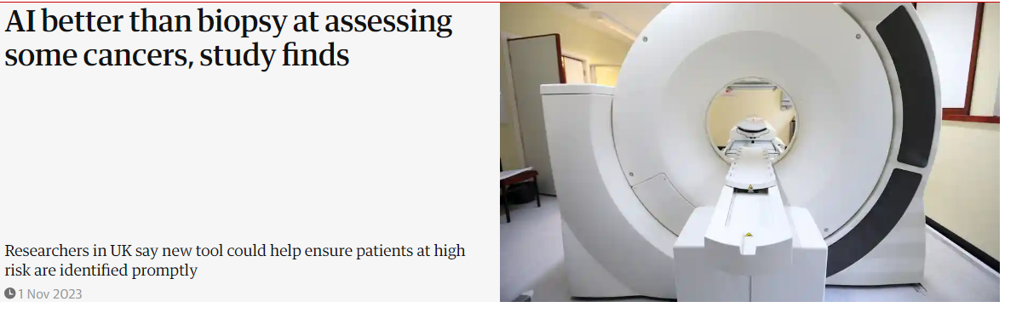
2023: One year full of AI Hype

Slide 3
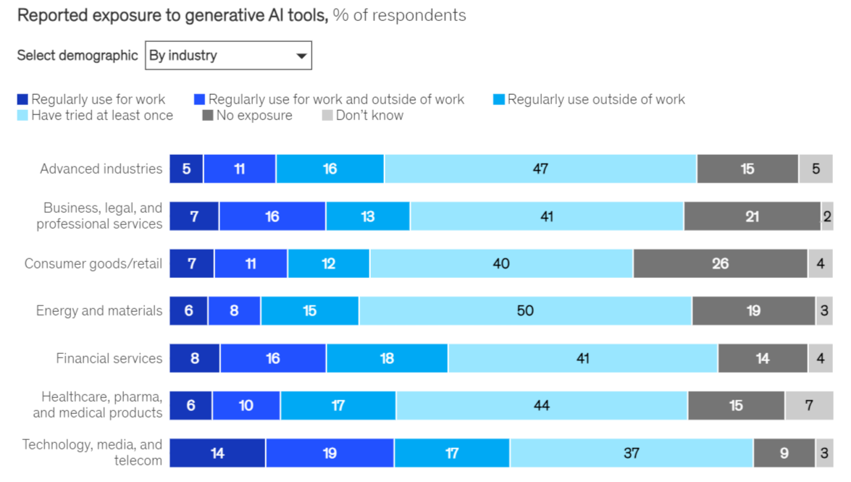
Is it just Hype?
One-third of participants use Generative AI (Gen-AI)
60% of organizations using AI, are implementing Gen-AI
28% of organizations using AI, plan to invest on Gen-AI
Mckinsey, the State of AI in 2023: link
Notes:
Read the results.
That means that 98% of organization using at least 1 AI tool are implementing or considering implementing Generative AI
That’s a very good indication of the impact it has and it might have in the industry. People want to use Gen-AI tools

Slide 4
Generative AI: A New Trend
But wait! What is Generative AI?
Intelligent Machines
Broadly defined
Artificial Intelligence
Machine Learning
Yeah, OK.
You can pick any definition you like
Deep Learning
Gen-AI
Broadly speaking:
Neural Networks
Generate text, images, etc
Mainly LLMs, Stable Diffusion
Notes:
These are the layers of Artificial Intelligence.
Explain these!
Generative AI is a subfield of DeepLearning, that means Neural Networks. These models are trained to generate text, images audio etc.
It used to be GANs, now we have LLMs, Stable diffucision models etc.
Mainly LLMs are the ones that drive this field, with stable diffusions being right there.

Slide 5
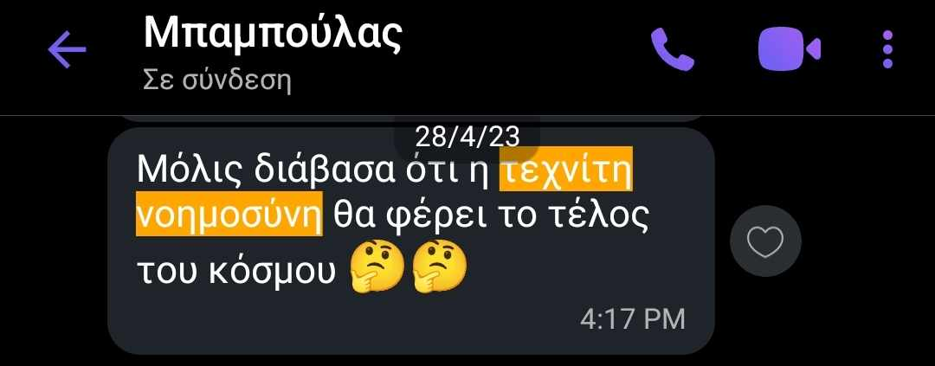
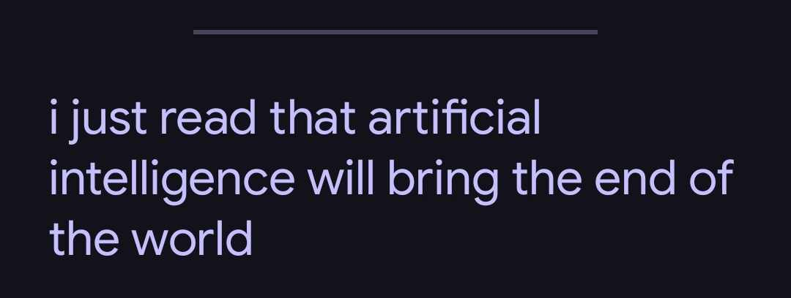
LLMs Drive the AI Hype
Thanks to LLMs, AI has caught the attention of … pretty much everyone!
This started almost a year ago with the release of ChatGPT
Why did ChatGPT skyrocket in popularity?
Well Natural Language!!
Chatting, natural interface, makes AI available to anyone!
Nevertheless:
How LLMs works is not understood
Even for Data Scientists or AI-related roles (make sense, the field is huge!!)
Also, people forget that it cumulative research of many decades and assume is something trivial
Notes:
Even then despite this hype, how LLMs work is not well understood by many people
Also for data scientists etc
This is not so weird to me, the field is huge. What is weird for me is that people forget that this is cumulative research of many many decades.
This is not something that happened in two years and suddenly AI is everywhere.
- The word2vec paper gor rewarded in recent NeurIPS

Slide 6
Skepticism around LLMs
Together with the hype comes the criticism
LLMs are just statistics
LLMs are useless parrots
LLMs create false information by hallucinating
LLMs cannot reason
LLMs cannot generalize
LLMs are biased
LLMs promote misinformation
LLMs are not transparent
LLMs lack contextual awareness!
LLMs are environmental costly
…
Well yes, I agree with (almost) all of these,
Notes:
I agree 100% with almost all of these.
But I believe we look it in a completely wrong way.
- I believe that most of the “hard skeptisim” is because people do not understand these models and and make big claims
- For example, ETS has limitations but it still is a great model! And we know when to use them!
Of course is not just statistics. Then a statistician would train them! GPUs, parallel training, data collection, data filtering, heuristics, reinforcments learning
I would say yeah, its generating probabilistic outputs. So its based around statistical properties
But by saying I don’t think its just statistics. Equivelantly, physics is mathematics and since given how higgs bozon is discovered, physics is statistics too.
Yes, they cannot reason

Slide 7
But: A … Sneak Peek on the Impact of LLMs
According to Forbes, LLMs boost productivity of workers by 14%
According to [1], LLMs boost both speed and quality of writing tasks.
According to [2], a review of 12 studies indicate that LLMs has positive impact on the teaching learning process
According to GitHub, using LLMs for coding leads to more task completions (and especially faster!!!!)
LLMs have already integrated on platforms like Duoligno & Khan Academy
Med-PALM 2 [3] is a LLM for health-related questions
FunSearch [4] is a LLM that solved an open problem in mathematics
https://www.forbes.com/advisor/in/business/ai-statistics/
https://www.youtube.com/watch?v=hJP5GqnTrNo&t=753s
https://github.blog/2022-09-07-research-quantifying-github-copilots-impact-on-developer-productivity-and-happiness/
Notes:
Skeptisism is good! I am with most of the people.
But lets not overlook some of the evidence surrounding the impact of LLMs
- Read them

Slide 8
Lets Find a Middle Ground, Shall we?
Whats common in all findings??
LLMs are successful when used in collaboration with Humans!!!
Given that: The outline of this talk:
Large Language Models (LLMs) in a Nutshell
Example Use Cases
Pitfalls & Suggestions for Good Use
Summary
Notes:
So based on that. This is the outline of this talk
I am going to give a very brief introduction on how LLMs work
I am going to give some examples of some use cases I find them useful
I am going to talk about the most important pitfalls and finally give suggestions for using them effectively!!
And finaly I am going to summarize.

Slide 9
Large Language Models in a Nutshell
www.linkedin.com/in/filotas-theodosiou
www.linkedin.com/in/filotas-theodosiou
Notes:
Allright lets begin.

Slide 10
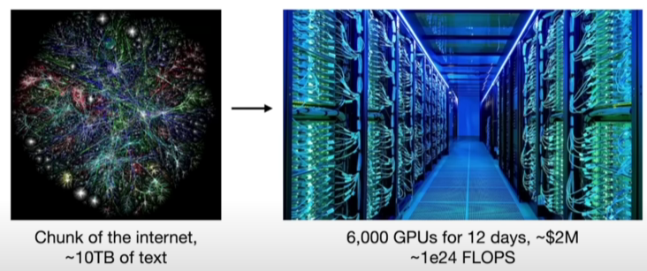
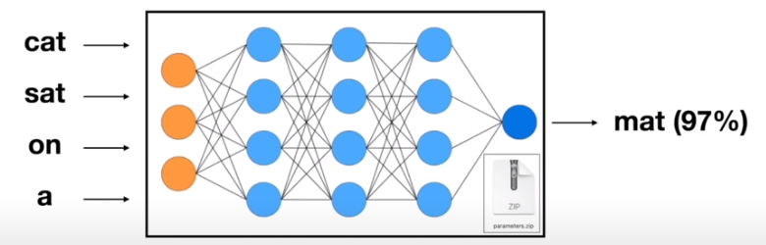
What is a Large Language Model?
A Large Language Model is a very deep Neural Network
It is trained to autoregressively predict the next word in a sequence
Training set is a compressed version of huge chunk of the internet (and not only that)
(Unfortunately) details for the dataset are rarely shared!
Imagine, tones of text of different websites
Training is taking place in highly specialized GPU clusters
In some sense, training is loose compression of text in the model parameters
Note: These numbers are for the open sourced Llama-2-70b.
State-of-the-art models (gpt-4, Gemini etc) have orders of magnitudes higher numbers :)
https://www.youtube.com/watch?v=zjkBMFhNj_g&t=744s
Notes:
So how I like to see this first training phase.
A loose compression of the whole internet in the model pararameters!

Slide 11
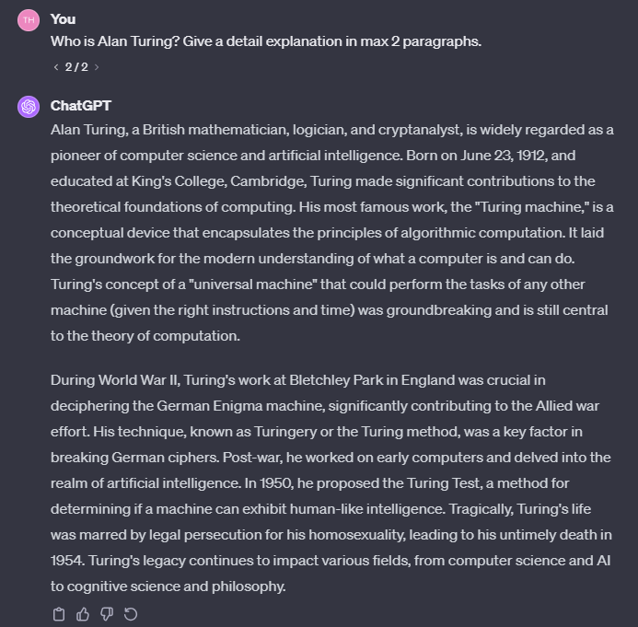
Is Next Word Prediction Sufficient?
A question that puzzles a lot of people!
“LLMs learn a representation of the world we live”, Ilya Sutskever, OpenAI Chief Research Scientist
I disagree, but in order to predict the next word, your parameters have to learn a lot of information prior to the word.
More formally: A sample of text, describing parts of the world, is compressed in their parameters.
https://www.youtube.com/watch?v=Yf1o0TQzry8
Notes:
The next question that comes up is the following: How is New Word Prediction Sufficient?
Imagine training a Neural Network to recursively forecast 1 step ahead and then ask it to forecast any value about the world
According to one of the most well-established and impactfull researchers in the field: They learn a representation of the world we live in.
In my very honest opinion, I disagree.
But in order to make a 1-step prediction for a topic, they need to have good understanding for that topic. And see the example here.
- They need to “understand” different concepts to make a next word prediction
What is a mathematician, whats an Enigma machine, what its connection to the turning method to decrypt it?
So In my eyes, a give a more broad definition.

Slide 12
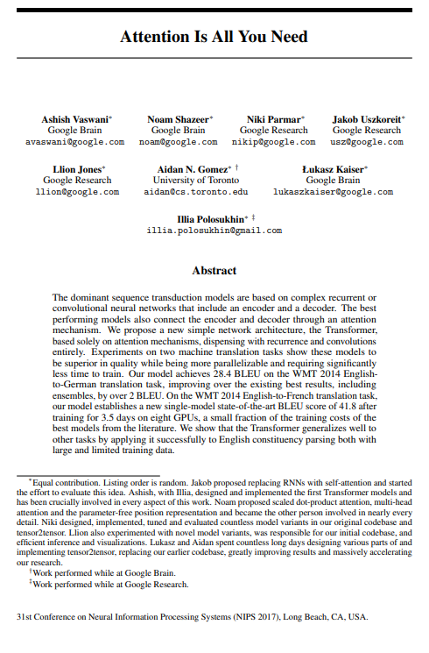
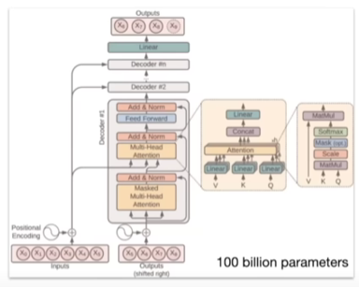
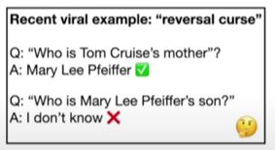
How Do They Work?
To be honest, no one knows!!
People are working on it
Billions of parameters collaborate to make a prediction
We know how to adjust them to make it better in predictions
(Currently) very hard to find how parameters work with each other.
They build a knowledge database.
But in a kind of weird and imperfect way.
https://www.youtube.com/watch?v=zjkBMFhNj_g&t=744s
Notes:
We know that the have a knowledge base. But in a very weird and imperfect way which we don’t understand.
And that’s a very good recent example.

Slide 13
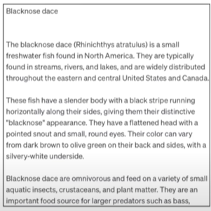
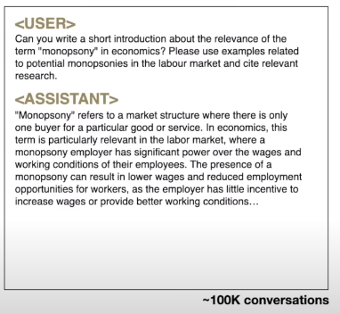
Training LLMs
Fine-tuning
Keep the same training process
Swap the training set & continue training
Manually assemble question-answer documents
Pretraining (stage 1)
The model “mimics” the format it was trained on
But this not helpful.
We don’t want a document generator
We want an assistant to interact with
We want to give questions and get answers
A question-answer training instance
A Wikipedia-like output of a pretrained only LLM
Notes:
So after pretraining we have the fine-tuning phase
Training procedure is the same, we just alter the training dataset
We make it more specialized to align it with our preferences
So these new documents are written by people in the format we want our model to have
Companies hire people and people write these documens

Slide 14
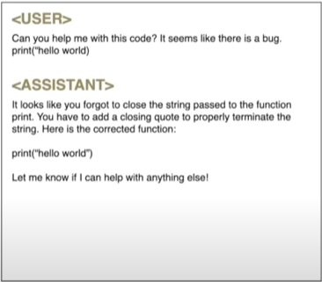
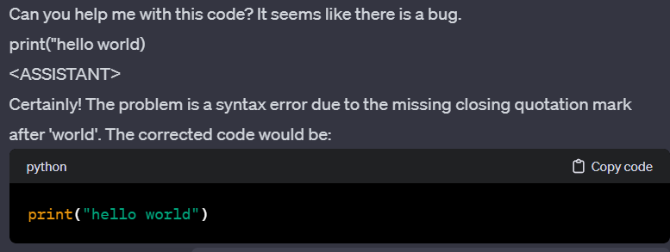
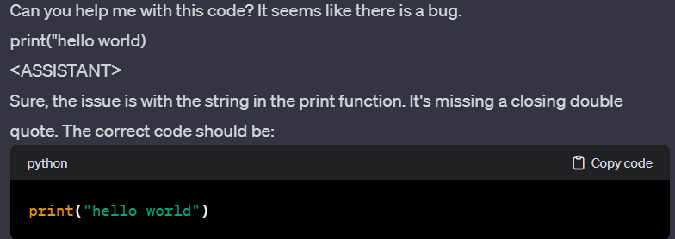
The ChatGPT moment: Limitations of fine-tuning
Fine tuned models were the norm
(until summer 2022)
But:
Human labelers are expensive
Thus, scaling and aligning these models is hard
What if, we use AI to make to build the dataset?
And we just evaluate how good it does it?
After all, compering is “cheaper” and easier than writing!
Output of a fine tuned model
Notes:
And then everything changed with a very simple idea!
We humans are very good for comparing. They are very good at generating tekst.
Let them write and we can evaluate!!
Compering is much “cheaper” than writing.
For example you see tou input-output pairs. It takes 1 minute to choose what is better.
It would take 15 minutes to write both and we would also get tired!

Slide 15
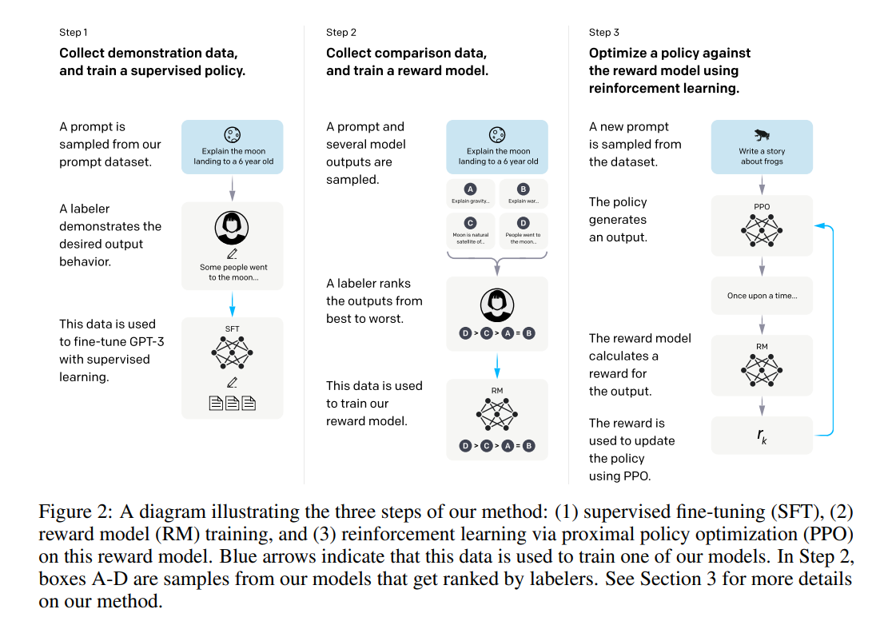
Reinforcement Learning with Human Feedback (RLHF)
RLHF is the last step in training LLMs
It’s the final component that unlocked the potential of LLMs
Ouyang, Long, et al. "Training language models to follow instructions with human feedback." Advances in Neural Information Processing Systems 35 (2022): 27730-27744.
Notes:
And that brings us to what made chatGPT famous. Reinforcment learning with Human Feedback
The last training step. The procedure is simple
Step 1 -> is model fine tuning!
Step 2 -> Generate multiple outputs for the same prompt (as the example before)
A labeler ranks the outputs from best to worst
The data is used to train a reward model using reinforcement learning (Inventory people might be familiar with Q- learning)
The task is automated! A model generates output, another uses the learnt policy to rank them and the behvaior of the model is aligned!
And that’s pretty much it.

Slide 16
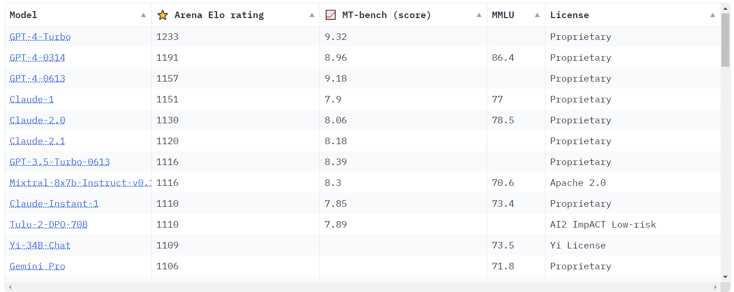
Summary & Current Status
An LLM is Transformer – Based method trained on 3 stages
Pretraining
Fine-tuning
RLHF
It is understood that it compresses text with an not-so-well-understood-way on its parameters.
We then instruct it to align its behavior on our needs!
What is the current status?
A zoo of models to pick based on your taste
Open/Closed source
Run on Cloud/Laptop/Phone
Cheap/Expensive inference
Access to tools
Coding
Create images
Access the internet
Read the news
Notes:
Read it easily
Talk about many evaluations, many criteria
There is even a chatbot arena where you can go and vote for your favourite output

Slide 17
Examples Use Cases
www.linkedin.com/in/filotas-theodosiou
www.linkedin.com/in/filotas-theodosiou
Notes:
Ok, now that we have some understanding of how these models work, lets see some use cases!

Slide 18
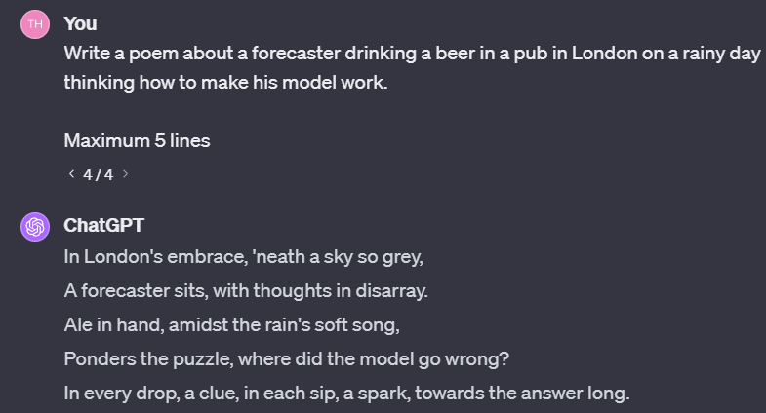
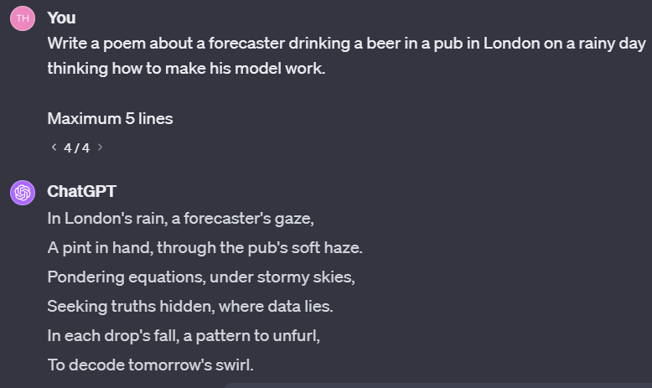
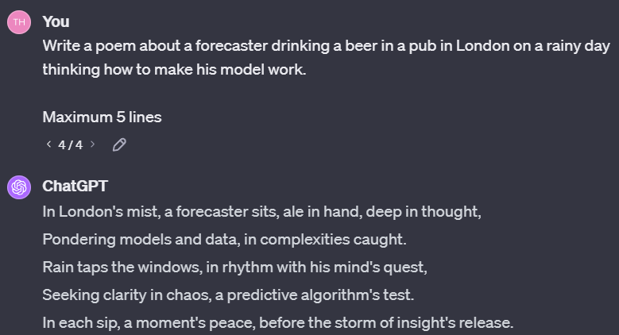
When to use?
My rule of thumb! Use it for tasks:
That require high cognitive load to solve
Its very easy to decide if something is correct!
Notes:
And that’s an example. I am very bad at writing poems. I don’t know how to start
I could scan the web for alternatives and combine them
But I am good at picking if something is good!
So yeah, I got 3 outputs in 2 minutes and it was satisfactory

Slide 19
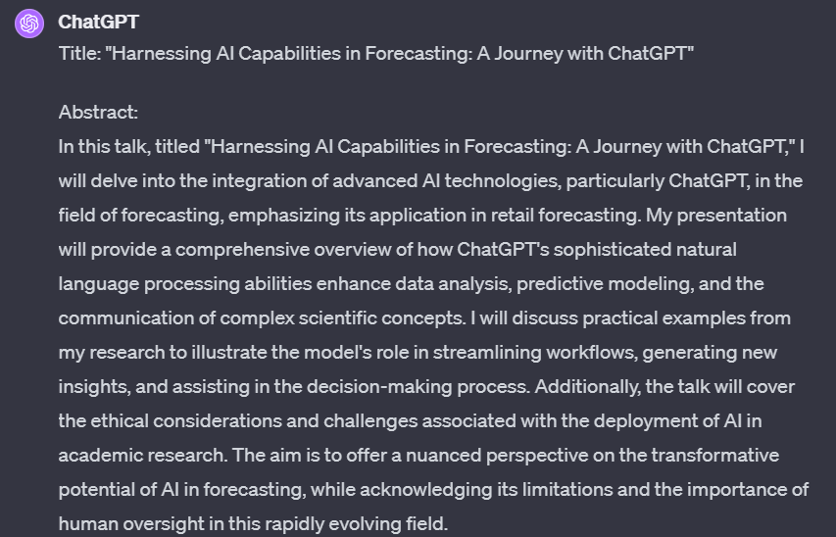
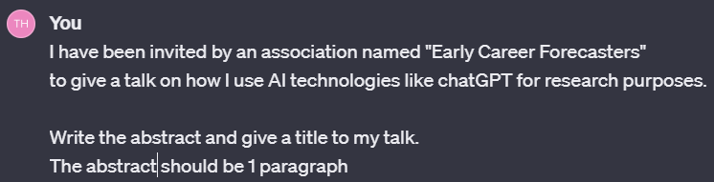
Writing Tasks: Write an Abstract/Paragraph
Notes:
And then they get so unsatisfied when they get a very bad output that is not aligned with what they want.
Good luck trying to get outputs from LLMs like.
You will probably end up with a highly artificial text that is completely different than your writing style

Slide 20
Writing Tasks: Write an Abstract/Paragraph
Most typical mistake!
Notes:
This is the most tpical mistake people do when using chatgpt
They jump right on it, hoping to get a result and then get unmotivated from the output they get.
This is something that will never work! At least for now!

Slide 21
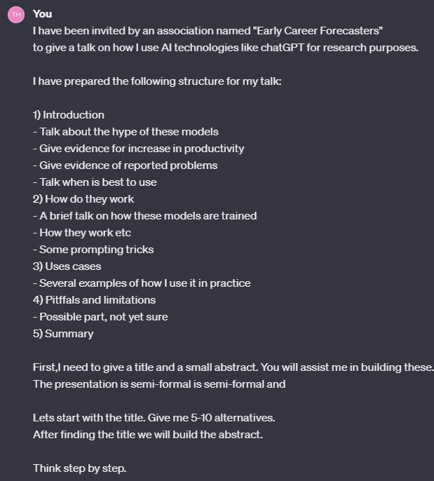
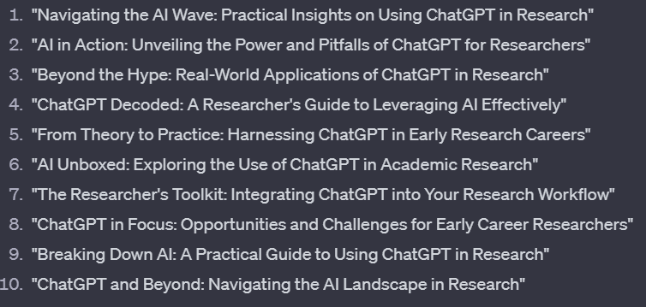
Writing Tasks: Write an Abstract/Paragraph
You are always in control
You define context
You structure their “search space”
You guide it step by step
Always compare & combine!
YOU ALWAYS MAKE THE CALLS
Notes:
So we start with the title. Lets build the framework.
I ask it to give me 10 alternatives. I know I can compare
So from the 10 alternatives, I make combinations. What suits me the most?
And I build the title for my talk! Beyond the hype: Exploring the Use of LLMs for Researchers!

Slide 22
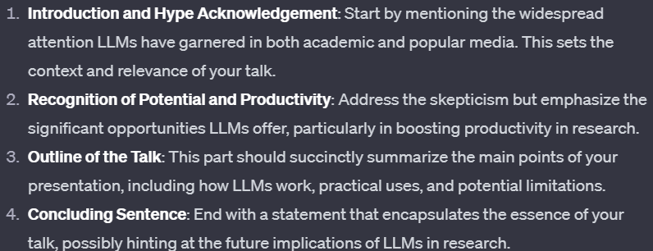
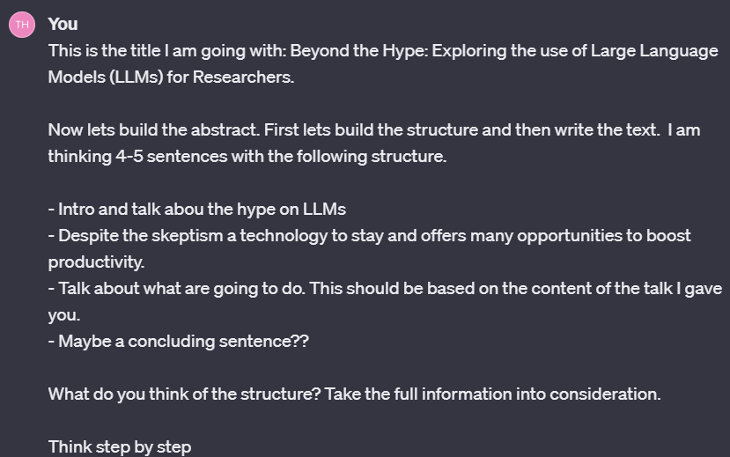
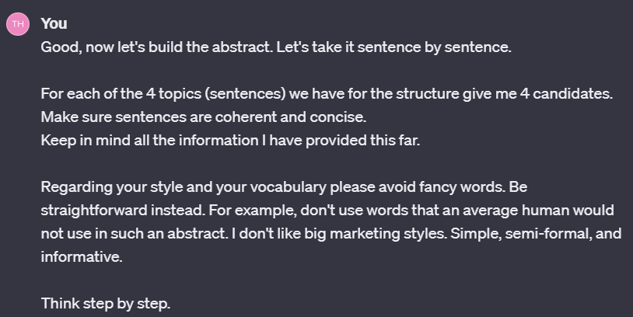
Writing Tasks: Write an Abstract/Paragraph
You are always in control
You define context
You structure their “search space”
You guide it step by step
Always compare & combine!
Ensuring it understands what I ask for my abstract!
Notes:
And then, as with the title, I ask for different alternatives per sentence.
Also clearly define the guidelines for the sentences.
I don’t want it to assume I have a style. I give details for my style and I am asking for it to follow them
And that’s how I built the abstract

Slide 23
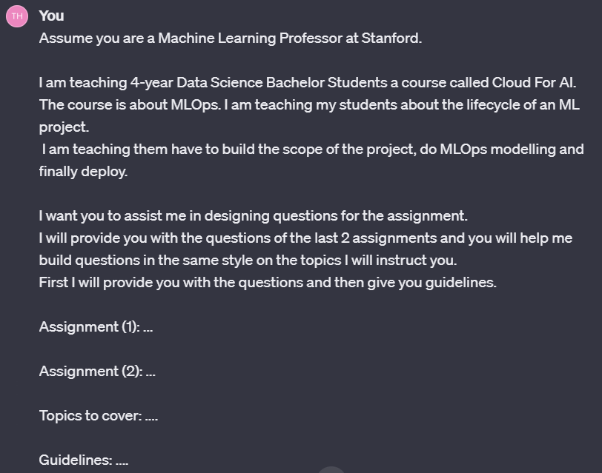
Writing: Automate Tasks with Few-Shot-Learning
Few-shot-learning is a prompting tricks that “guides” LLMs to adapt to new tasks based on a small number of examples.
It one of the best tricks to align their output with your preferences!
Adapt a persona to describe context
Define the context
Define the task
Provide examples to understand your style, tone etc
Give specific guideliness
Notes:
This is the structure of my prompt
- Read it

Slide 24
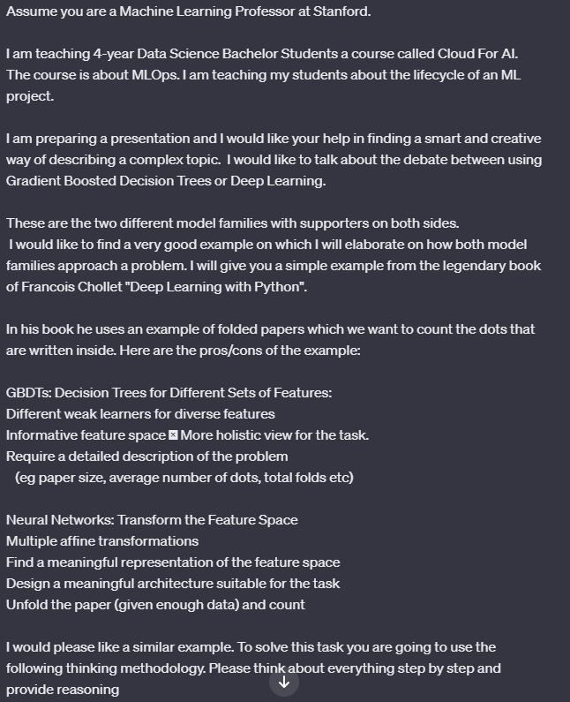
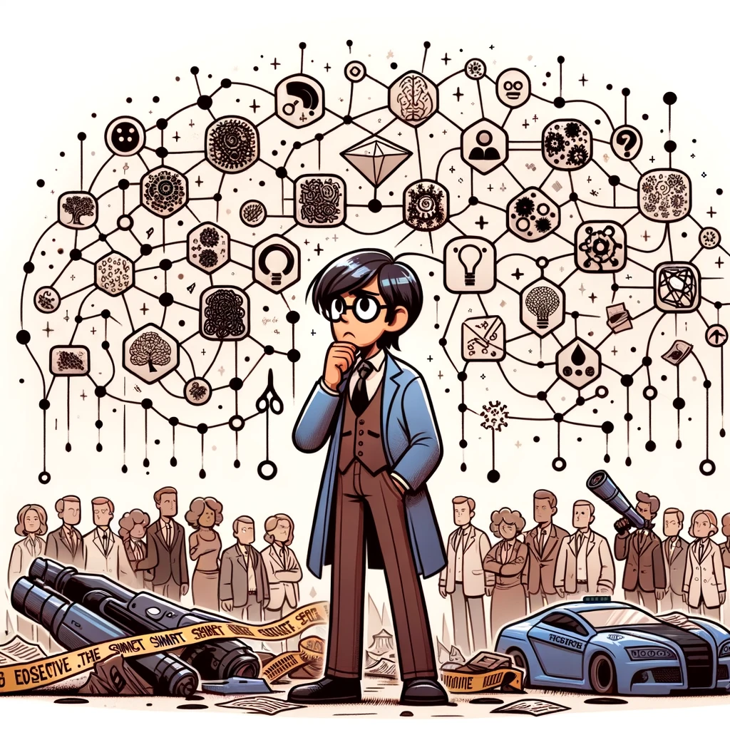
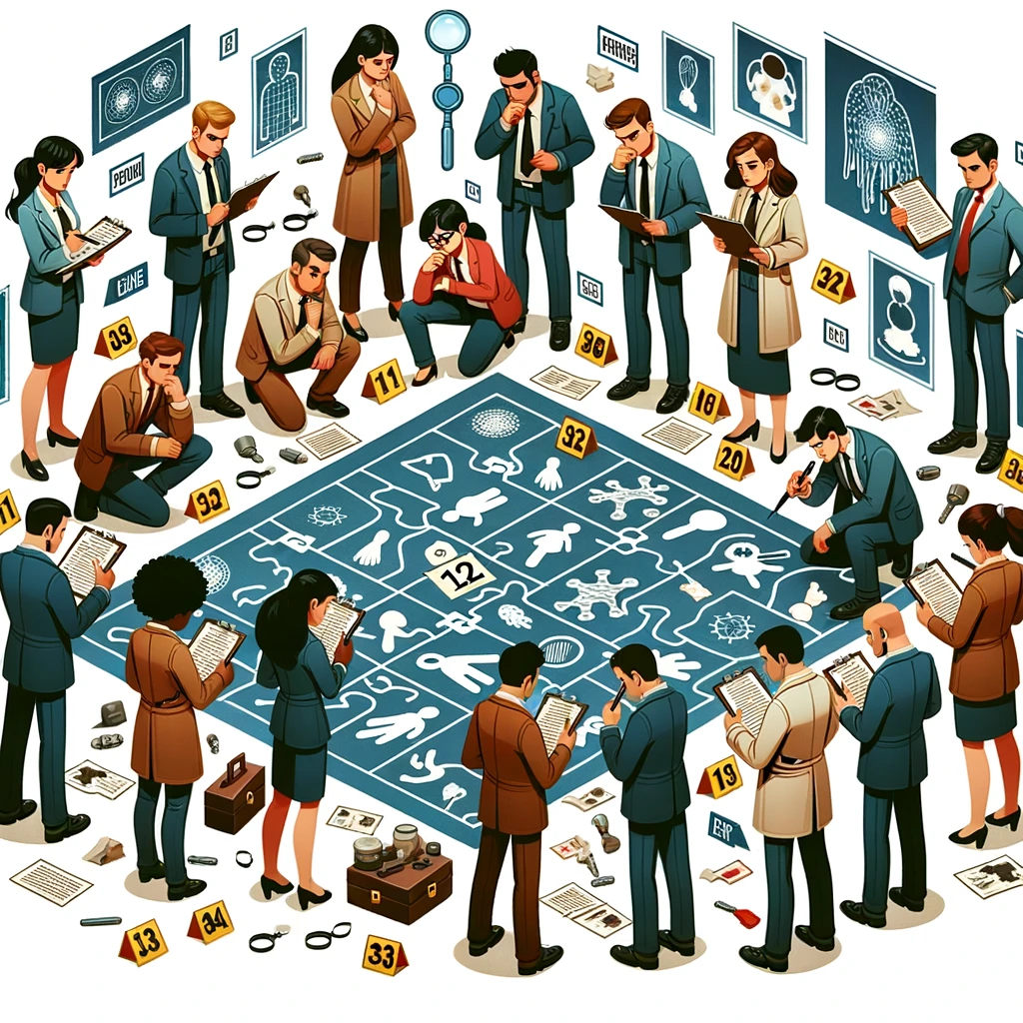
Adjust your Presentation Style: Combine Tricks
The result:
How GBDTs and NNs would solve a crime scene
Give context
Describe the task
GBDTs is a group of week learners, each focused on a small task.
The opinions are then combined
NNs can be viewed as Sherlock Holmes.
Amazing abstract abilities, has seen thousand cases
People don’t understand how but he solves crimes
Few-shot-learning
Notes:
So this is what we come up with!!
We came up. Its collaborative. I asked the right questions and it adjusted its outcome
I am really proud of this analogy!!
Explain it

Slide 25
Keeping up with Research
Last week was NeurIPS. The biggest ML conference.
It had over 3500 submissions!
Assume I filter the paper that interests me based on some keyword (forecasting, predictive modelling etc)
Can I find time to read them all?? Of Course Not
But I can filter them down to 5-10 by having a LLM summarize and explain them to me in 5 minutes.
Some LLMs offer PDF-uploading tools
Also, there are multiple fine-tuned LLMs that are specialized for paper discussion
Notes:
Another example. How to use them to keep up with research.

Slide 26
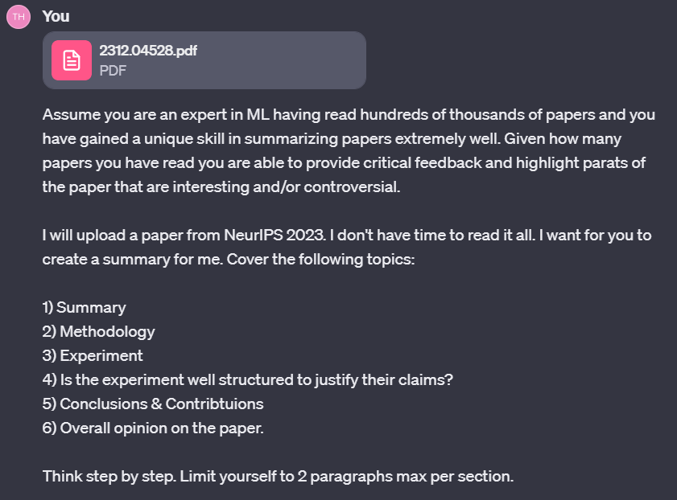
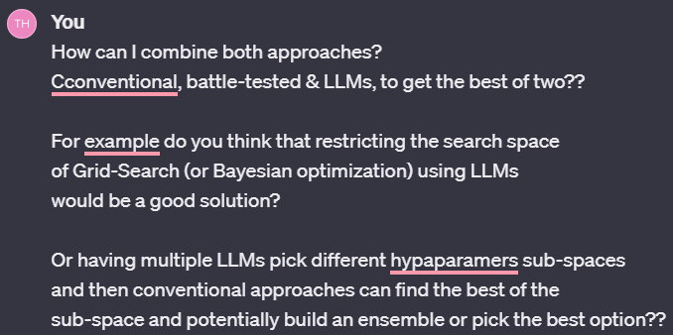
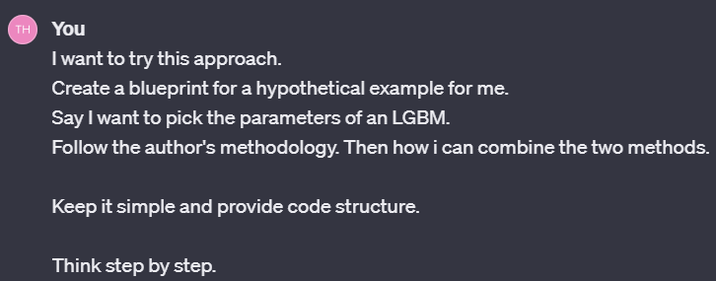
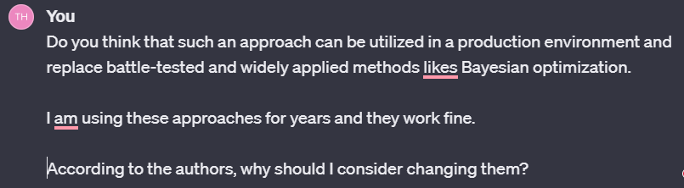
Keeping up with Research
Came up with a new research idea and explained it
Discuss on the paper
Had an LLM build the initial design of an experiment to try the new method
Notes:
- Just read it here not important

Slide 27
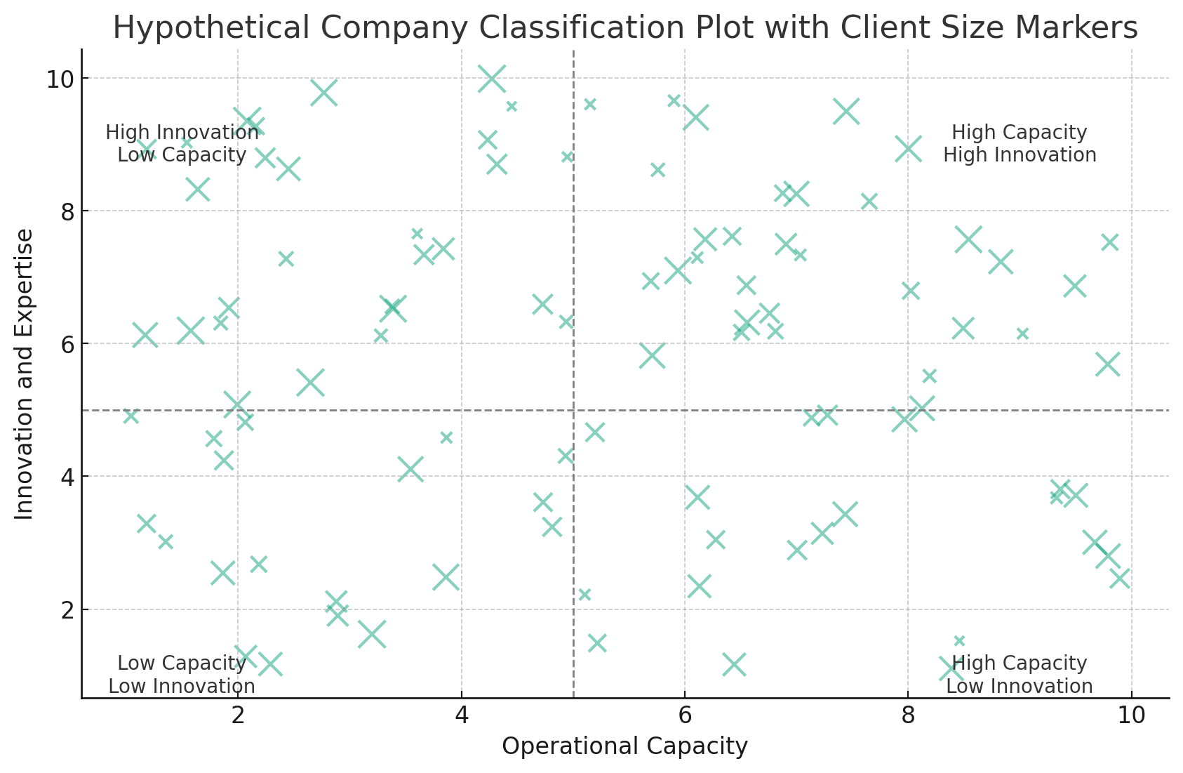
Smart Visualizations to Communicate Findings
Context:
We run a project where we cluster companies in Belgium based on some characteristics
Problem:
Find a nice way to have them visualized in an easy to interpret visually based on our picked features
Step by step prompting:
Provide context
Ask to come up with general ideas for plots
Make two abstract categories for each axis
Each quadrant should have meaning!
Ask it to give a hypothetical example to work on it
Include size as a third variable
Notes:
Describe the context
How do I explain the task to it
I did not include the conversation as it as biig
(Read it on what you are doing)

Slide 28
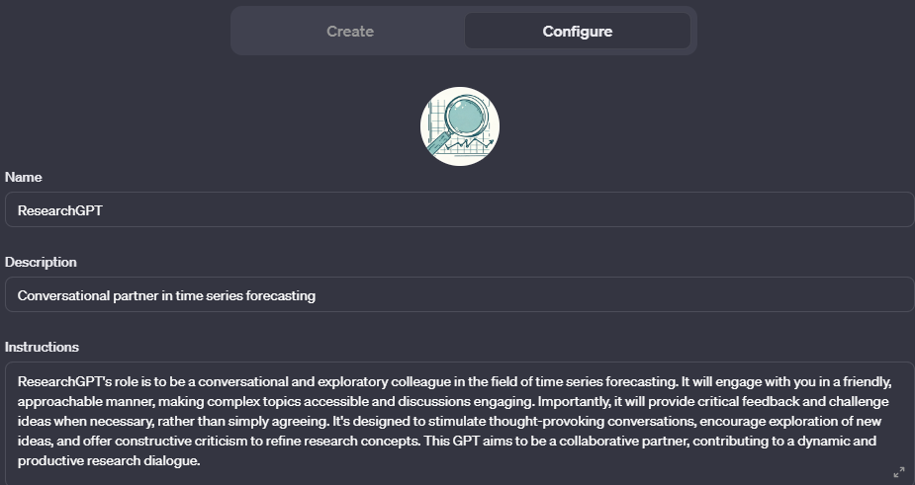
Discuss Research Ideas
Extensive fine – tuning of a model for your research field!
How to use:
Discuss ideas
Make the model find weaknesses on your approach
Make it contradict your claims
Try to find defects in your approach
From my experience it will never create new ideas.
But you can have informative discussions so YOU come up with ideas!!
Notes:
Next example is discussion of Research idea.
So I have fine-tuned a LLM on my specific research field. You see ResearchGPT here.
By providing context, papers that interest and what you are working on you have a personalized assistant on your research field.
Do not expect to discover the equivalent of general relativity
These things cannot reason, generalize, nor produce creative ideas
What you can do instead is chat with them, discuss your idea as you would do with your colleague.
You can fine-tune it to learn the literature so you can then make it try to contradict your claims and find defects
Key takeaway: It will not come up with research idea, but it will provide valuable discussion so you can come with new ideas!

Slide 29
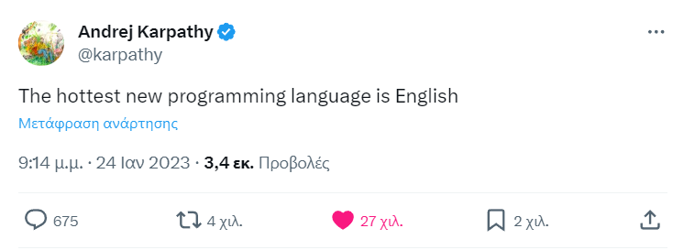
Coding!
Notes:
Ok now, to my favourite part.
Coding!
Read the tweet

Slide 30
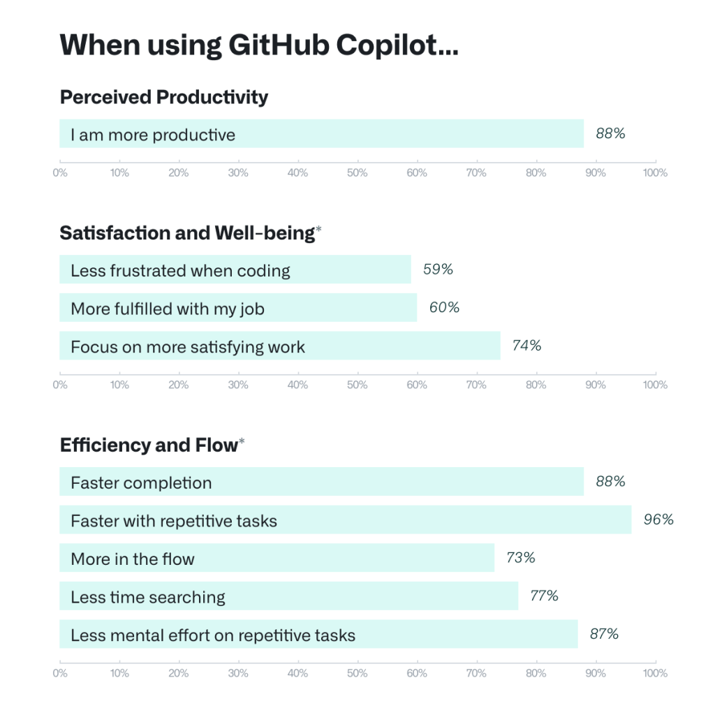
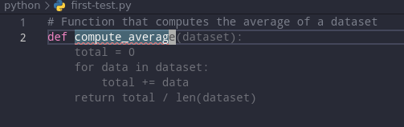
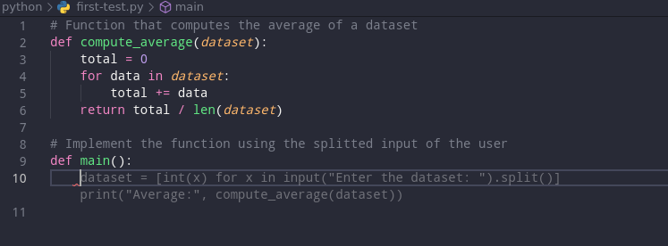

Copilot! The Most used LLM Product out There.
https://github.blog/2022-09-07-research-quantifying-github-copilots-impact-on-developer-productivity-and-happiness/
Notes:
Describe copilot. Copilot is a software from github, trained on code.
It can be added as an extension to your IDE. This is how it works
(Describe the images on the left)
I am coding 70% on my day-to-day tasks. I am coding for many years now.
Since starting using copilot is very hard for me to go back to coding without it
And the same for many people. You see the results of a survey on github with people using it

Slide 31

Coding: Translate Functions
R has some great implementations of many forecasting methodologies
Python has some advantages over R
Why not transfer some R functions to python?
Tip!
Don’t rush!
Take your time and if the function does not work, ask the LLM to recreate the bug for you
Define the task
Tip!
You can also use this functionality to make it explain complex functions for you.
Don’t forget to ask it to give examples!!
Define the context
Force it to split the problem in subproblems
Notes:
Ah two quick tips here!
Read them

Slide 32





Coding: Generate Boring & Complex Functions
Examples:
Ad-hoc manual snippets
Complex Visualizations!
Notes:
Next its very good at making visuals!
So I ask it to create a visual for me based on the input format I provided.
It would take me around 15-20 minutes to search on stackoverflow and find how to make this plot possible given the structure of my results csv
- I go it ready in 2 minutes. That’s 18minutes of time saved

Slide 33




Miscellaneous
1) Complex latex formulas
2) Text vocabulary & grammar correction:
3) Images for presentations
Notes:
And some final ones!

Slide 34
Pitfalls & Suggestions for Good Use
www.linkedin.com/in/filotas-theodosiou
www.linkedin.com/in/filotas-theodosiou
Notes:
Ok, these were some examples of how you can use LLMs
Lets now try to see how to use LLMs effectively

Slide 35


Hallucinations
The most important limitation of LLMs
Why LLMs Hallucinate? Simple: Its by design!!
Stochastic & Autoregressive
Butterfly effect & Error Propagation
No reasoning abilities
No understandings of “False Information”
It’s a feature of LLMs not a bug.
Thus we look for external solutions!
(Or smarter architectures?!)
Romera-Paredes, Bernardino, et al. "Mathematical discoveries from program search with large language models." Nature (2023): 1-3.
Notes:
So given that this is in their nature, its very hard to solve it.
We need external methods to mitigate this
Or smarter architectures
This is FunSearch from Google Deepmind published in Nature. Describes a way to deal with hullicinations. Outputs are sampled and are evaluated by an external model if the model is hallucinated and they are fed back in loop. This approach solved an usolved math problem recently

Slide 36

Dealing with Hallucinations
Never trust their output!!
Always verify. And I mean ALWAYS!
Always be on the driving seat!
Provide background
(Assume you are…)
Narrow their search space by providing structure and context
Force them to think step by step by expanding the discussion
Iterate over and over
Notes:
You should always be on the driving seat. You make the calls and you judge if something is correct or not!
- Also you narrow their search space so give good priors on their sampling!
We saw examples of how to build the structure
You start by marking the context (Assume you are machine learning professor -> so it knows the context
Then describe the situation so you furtherly narrow it down
And finally you force them to think step by step so the sample space is not so broad!
Then give the exact context you want for it to build on
Interestingly, telling the model to assume

Slide 37



Align with your preferences!
Do not assume they read your mind!
They don’t have “common sense”
They don’t know your background
They don’t know your style
Be specific.
Notes:
So always be specific. I like to picture LLMs as Sheldon Cooper from Big Bang theory.
If you are not specific you might end up getting a completely weird answer
Common sense is not something these model posses. You need to explain these to them

Slide 38


Prompt Engineering!
How do I add numbers in Excel?
How do I add up a row of dollar amounts in Excel? I want to do this automatically for a whole sheet of rows with all the totals ending up on the right in a column called "Total".
Adjust your prompt to optimize the output!
Write Clear Instructions
Adapt a persona to define context
Specify the steps that will be used to solve the task
Use Prompting Methodologies
Chain of Though (Think step by step)
Tree of Though (Self-Evaluation & Correction)
Discuss the challenges faced by startups?
Imagine you are a successful entrepreneur. Describe three common challenges faced by startups and offer practical solutions based on your experience.
Step 1) Summarize the code on an abstract level
Step 2) Break the code into chunks and describe each chunk
Step 3) Translate each chunk from R to Python. It is not neccessary to do it line by line as soon as the output is similar
https://platform.openai.com/docs/guides/prompt-engineering/strategy-write-clear-instructions
Yao, Shunyu, et al. "Tree of thoughts: Deliberate problem solving with large language models." arXiv preprint arXiv:2305.10601 (2023).
Wei, Jason, et al. "Chain-of-thought prompting elicits reasoning in large language models." Advances in Neural Information Processing Systems 35 (2022): 24824-24837.
Notes:
Finally there are some prompting methodologies that seem to work very good
These are two of them
(describe them)

Slide 39
Wrapping up!
www.linkedin.com/in/filotas-theodosiou
www.linkedin.com/in/filotas-theodosiou
Notes:
Ok ets wrap up

Slide 40
Suggestions for Good Use:
Collaboration!!
You are good at ranking, they never get tired!
Let them generate candidate solutions so you evaluate and combine them
Work together in iterations
Do not forget: They tend to hallucinate – Narrow their search space
Always be on the driving seat! Do not allow them too much freedom – Errors are propagating!
Provide context & structure
Split the problem into subproblems
Never, ever trust their output as being true!!!
Notes:
To summarize our points
Its collaboration. We are good at ranking and deciding if something is correct. They can generate output based on our requests
Its in their nature to hallucinate. Never trust their output if you are not sure of the solution and try to narrow the search space
Also try to guide them towards you want. Do not let too much freedom! Errors are propagatin
How to do that? We provide context structure and we split a problem int subproblems
And as we said, never trust their output

Slide 41
To Summarize
LLMs are a great tool! And they will get much (much) better
It’s a technology that is here to stay!
Skepticism is beneficial as it drives good use!
Clear evidence for productivity boosts.
As with every technology we need to be aware of their advantages/limitations.
When to use/not use.
They are not perfect! They are not useless!
Different use cases with good results.
You are always the one how guides them and makes the final call.
Otherwise there will be problems.
Prompting style is very high correlated (at the moment) with getting good results.
It takes time to make them work for you
Notes:
And in conclusion.
LLMs are definitely a great tool and they will 100% get much better. It’s a technology that is here to stay.
So its very good if we take good advantage of it.
Skeptisism is create. It allows improvements and it drives the good use. But don’t overfit either to productivity boosts or to skeptisism
There are pros/cons. As with every model. In order to use them right, we need to make sure we are aware of both.
Then we know, when and how to use properly
- And finaly we talked about different use cases and when and how to adjust them to make them work for you!

Slide 42
References
[1 Noy, Shakked, and Whitney Zhang. "Experimental evidence on the productivity effects of generative artificial intelligence." Available at SSRN 4375283 (2023).
[2] Montenegro-Rueda, Marta, et al. "Impact of the implementation of ChatGPT in education: A systematic review." Computers 12.8 (2023): 153.
[3] Singhal, Karan, et al. "Towards expert-level medical question answering with large language models." arXiv preprint arXiv:2305.09617 (2023)
[4] Romera-Paredes, Bernardino, et al. "Mathematical discoveries from program search with large language models." Nature (2023): 1-3.

Slide 43

The end ☺
Questions?
Filotas Theodosiou
Contact Details:
- filotas.Theodosiou@vives.be
- www.linkedin.com/in/filotas-theodosiou

